Slide 1


Power Distribution
Shipboard Power System Fundamentals
Revision of 10 January 2026
Dr. Norbert Doerry
http://doerry.org/norbert/MarineElectricalPowerSystems/index.htm
© 2026 by Norbert Doerry
This work is licensed via: CC BY 4.0 (https://creativecommons.org/)

Slide 2
Essential Questions
What components comprise Power Distribution? | Remember
How are cables chosen? | Apply
What are circuit breaker trip curves and how are they used to predict clearing times? | Apply
How are circuit breaker trip curves used to coordinate series circuit breakers? | Apply

Slide 3
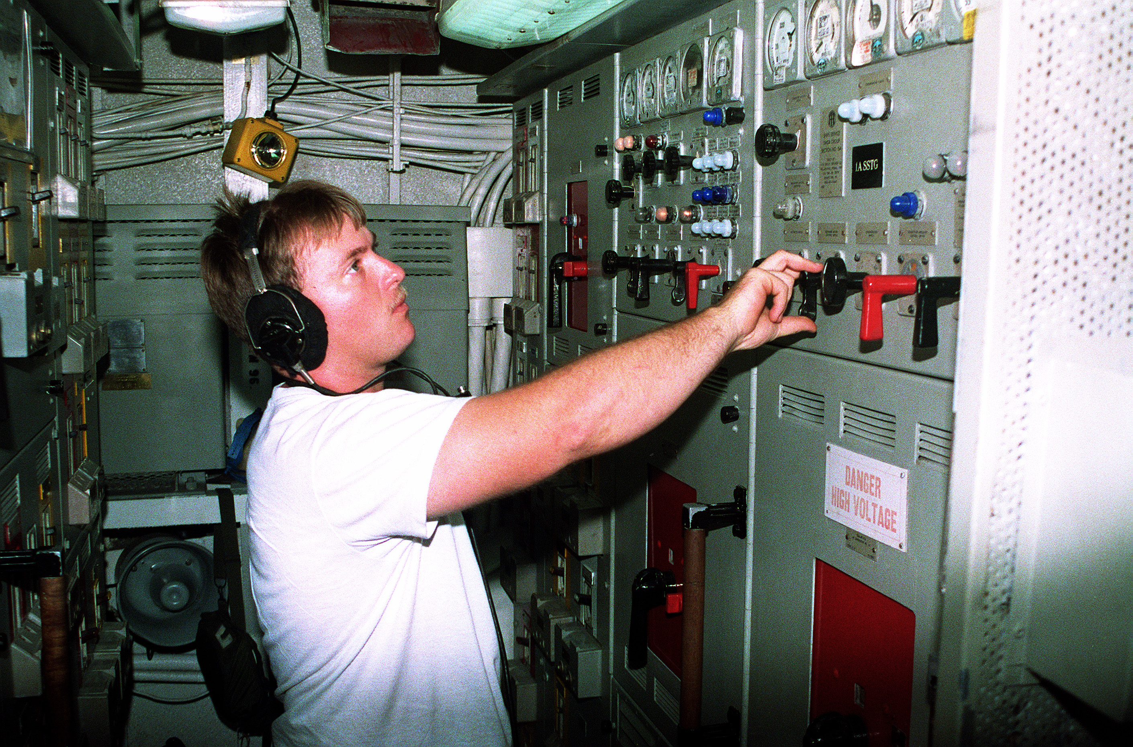
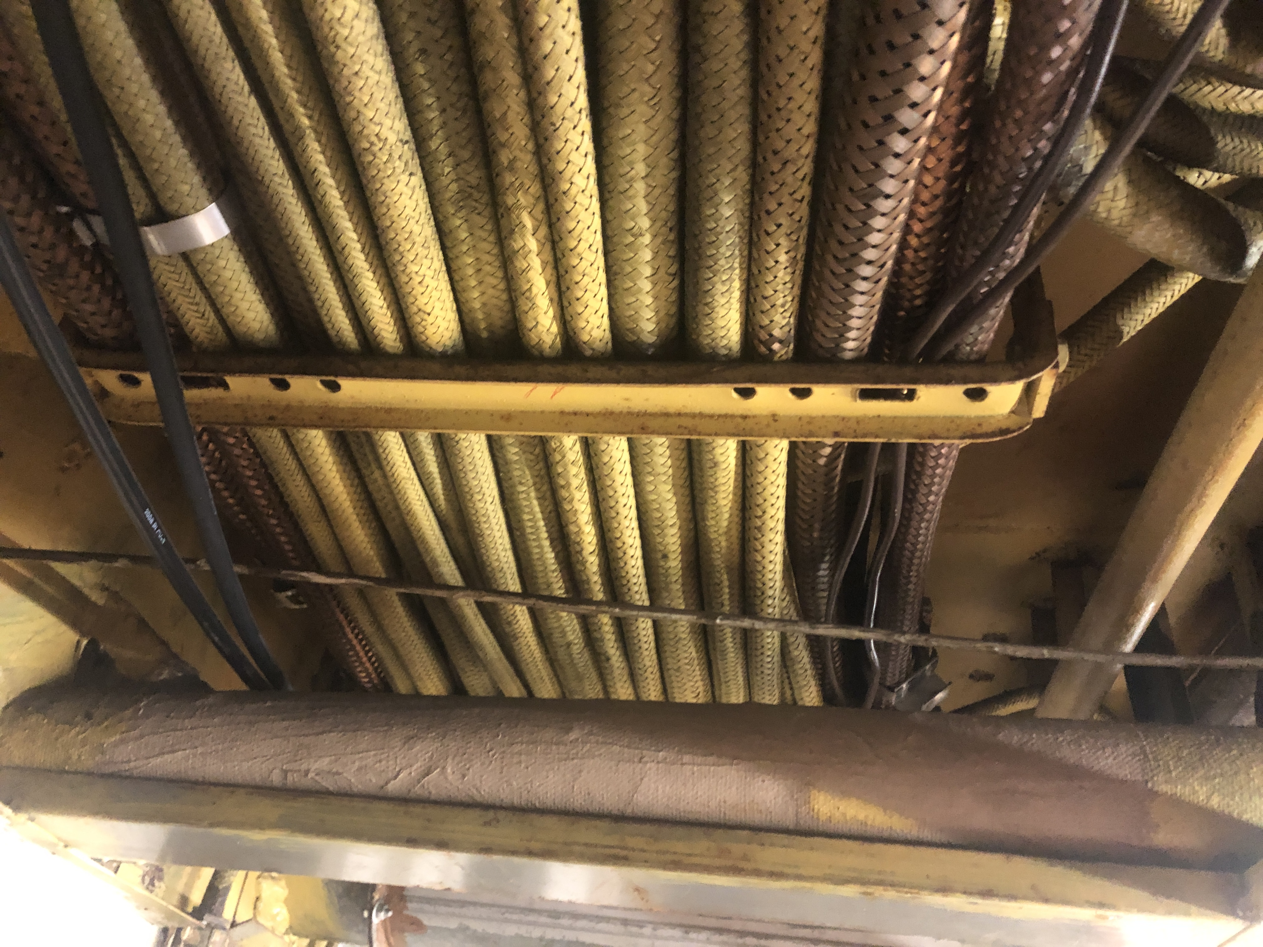
Introduction
Power distribution safely transfers electrical power among the other elements of a power system.
Power distribution implements the power system architecture.
Components
  Switchboards
  Load centers
  Power panels
  Cable – bus duct – bus pipe
  Bus transfer switches
  Shore power connections
  Grounding systems

Slide 4
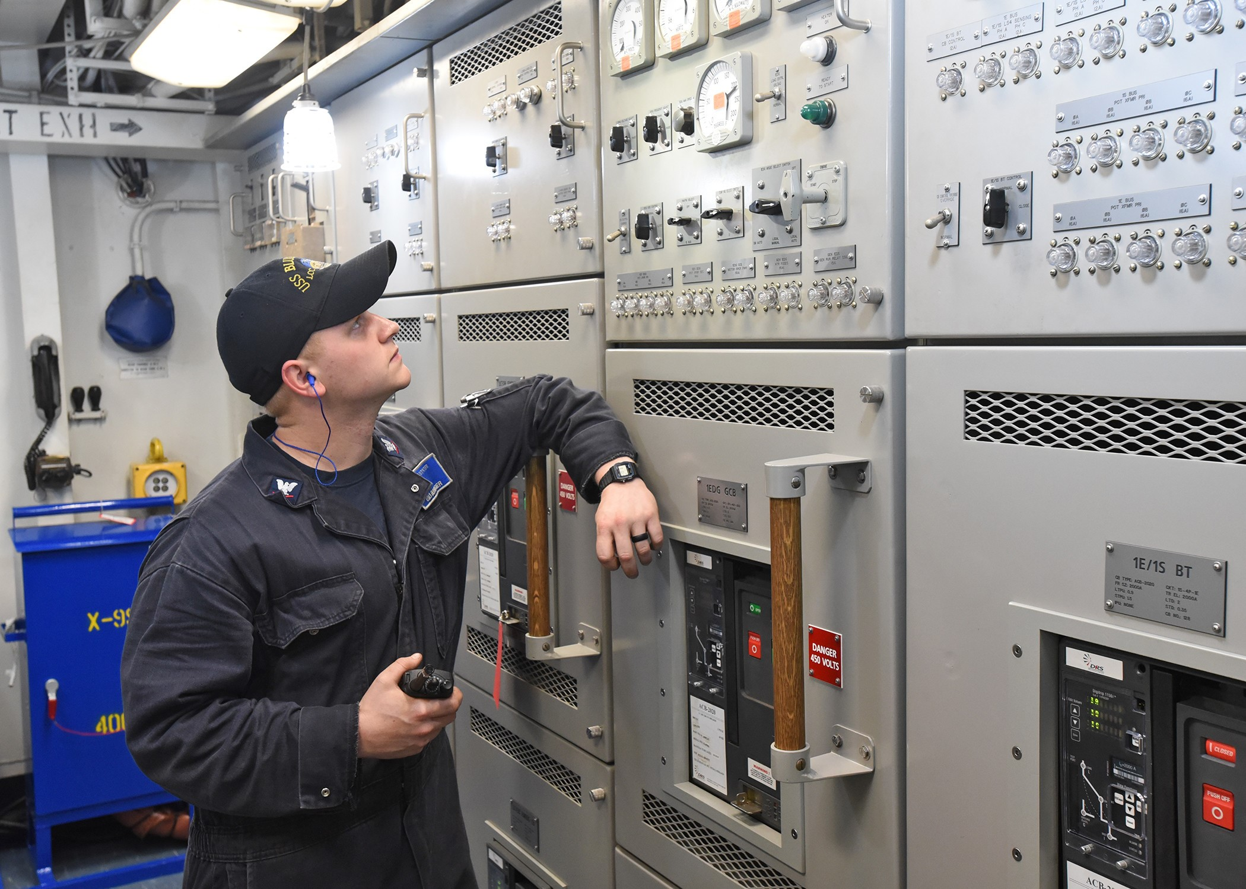
Switchboards
Contain large circuit breakers and controls.
  Typically deck mounted
Power sources typically connect to the distribution system at a switchboard.
Connect to other switchboards via bus-ties.
Supply power to load centers, power panels, and high-power loads.
May be the normal or alternate feed to a bus transfer switch.
A.C. switchboards typically do not include power conversion.
  All interfaces have the same voltage, number of phases and frequency.
D.C. switchboards may include power conversion.
  Rectifiers for interfaces to generator sets.
  Motor drives for thrusters and large pumps.
  Inverters for ship service a.c. loads.
  D.C. to d.c. converters for ship service d.c. loads.
  Special interfaces for energy storage.

Slide 5
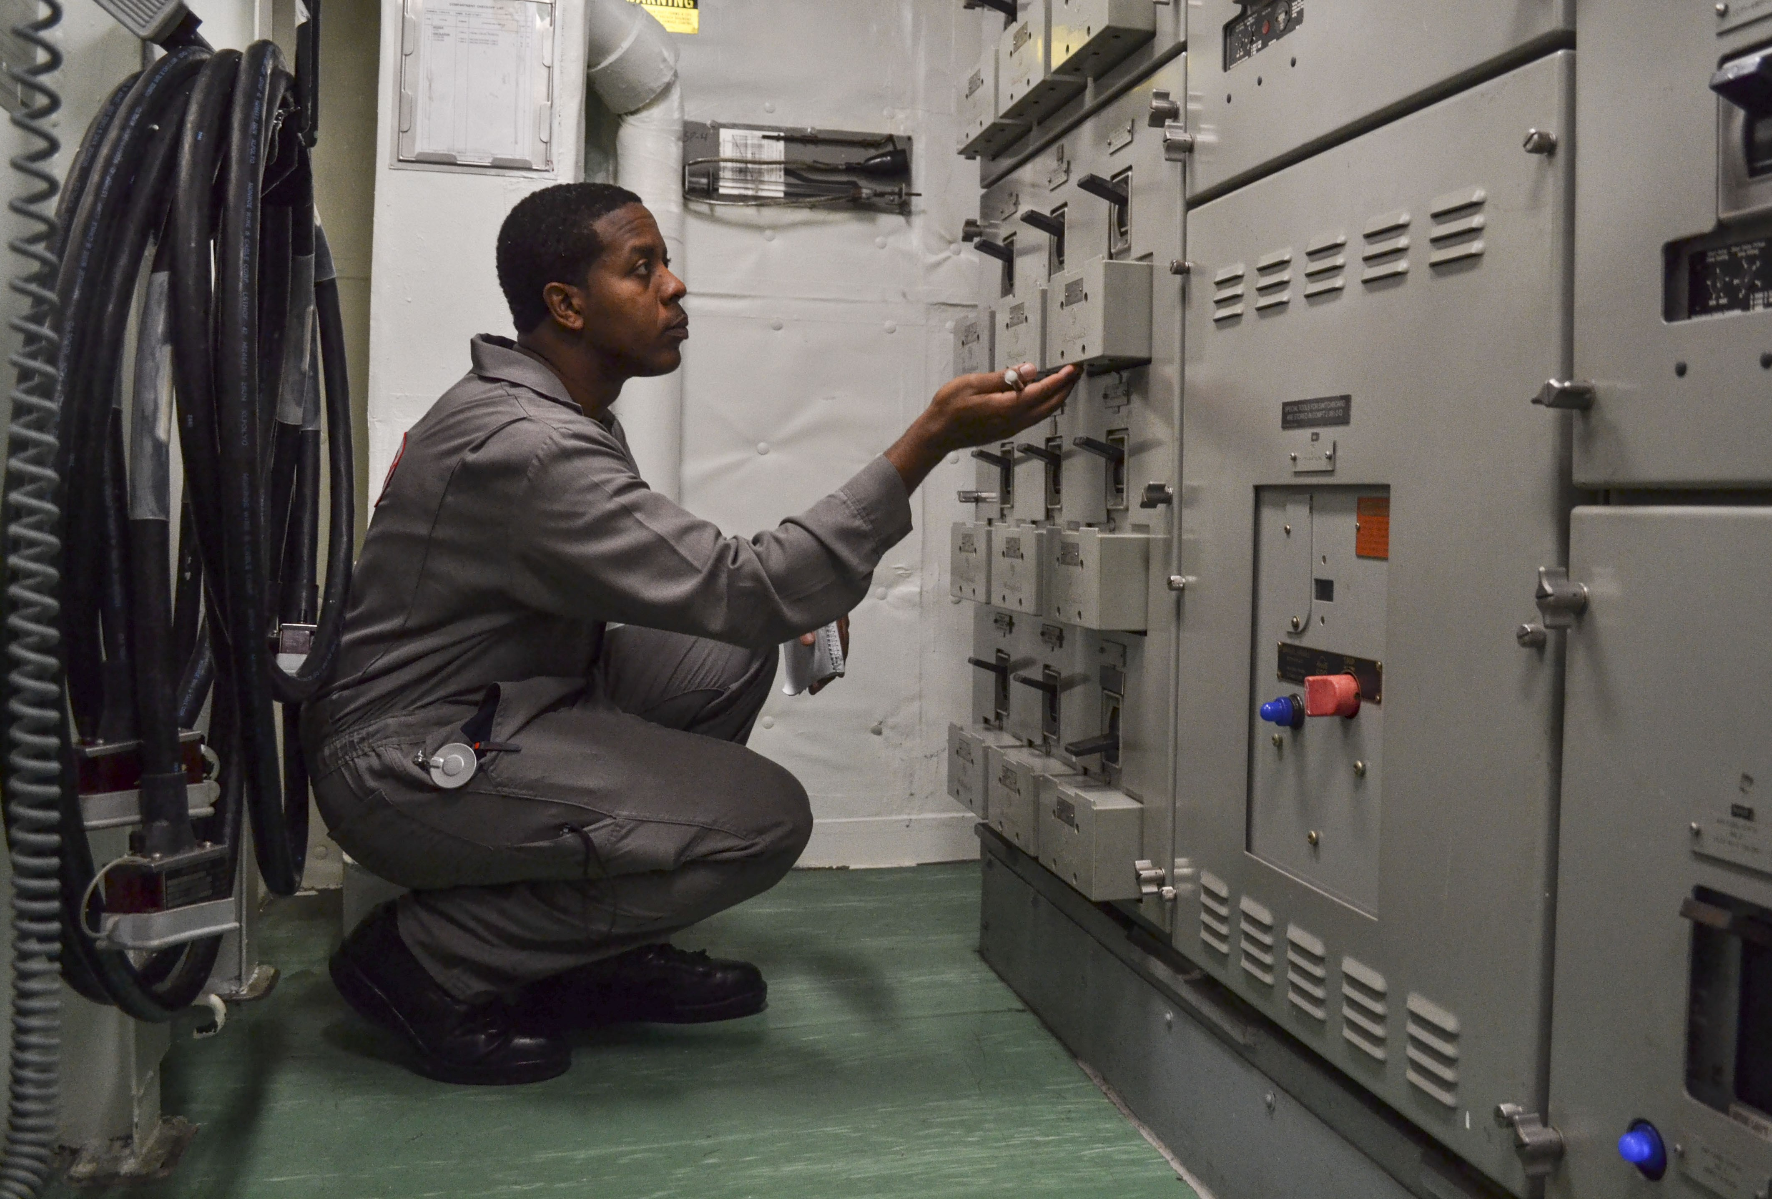
Load Centers
Contain large and medium size circuit breakers and limited controls.
  Typically deck mounted.
Normally powered from switchboards.
Provide power to large and medium size loads and power panels.
May be the normal or alternate supply to a bus transfer switch.
Normally do not include power conversion.
Smaller ships may not have load centers.
  Large and medium loads and power panels powered directly from switchboards.

Slide 6
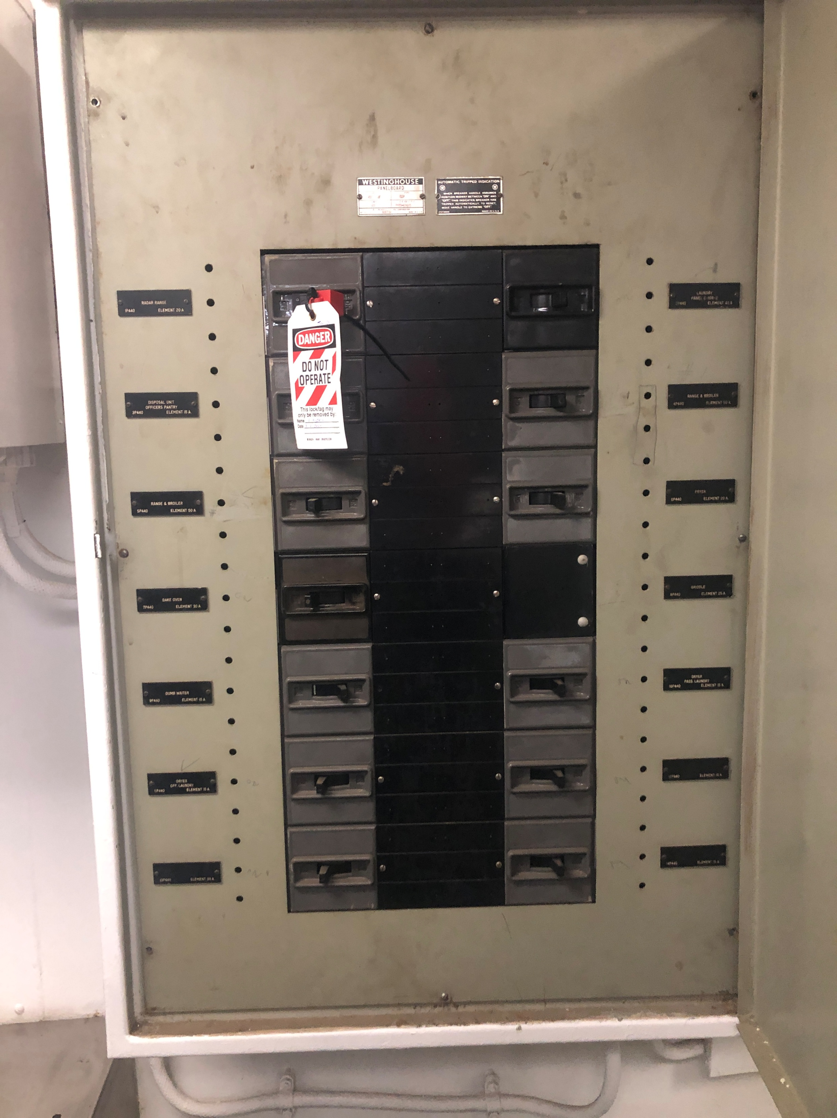
Power Panels
Contain circuit breakers for small loads.
  Typically, bulkhead mounted.
Normally receives power from a load center, switchboard, the secondary of a distribution transformer, output of a power converter, or the output of a bus transfer switch.
Provide power to small loads.
May be the normal or alternate source of power for a bus transfer switch.
Normally do not include power conversion.

Slide 7
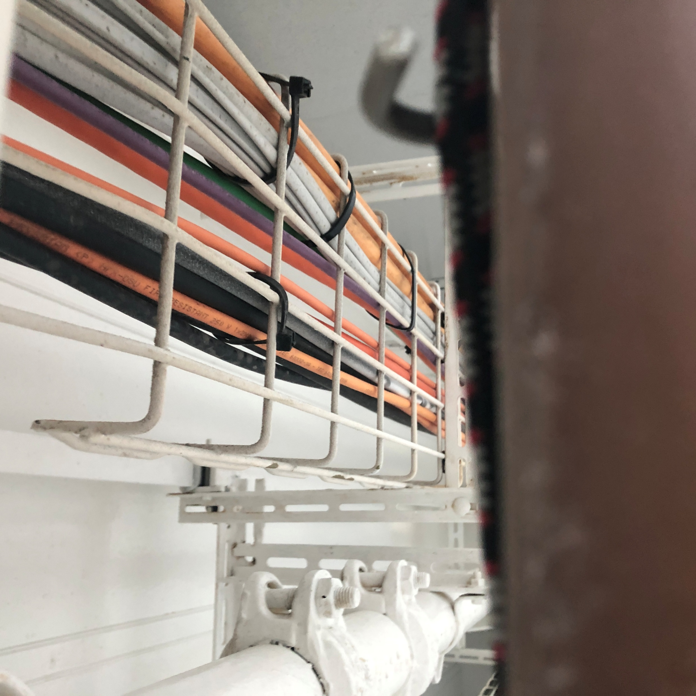
Cable
High power cables
  A.C.: three conductor for three phase power
  D.C.: four conductor for 2 phase power
    Two conductors for each phase to reduce d.c. magnetic field generation.
  Medium voltage cables also include shields and possibly drain wires.
    Control electric field stress on conductor insulation.
    Provide path for common mode currents.
Low power cables
  A.C.: typically, two conductor cables with possibly a protective ground conductor for single phase loads. May be three or four conductor cable for three phase loads.
  D.C.: typically, two conductor cables with possibly a protective ground conductor.
  May include drain wires if significant common mode currents anticipated.

Slide 8
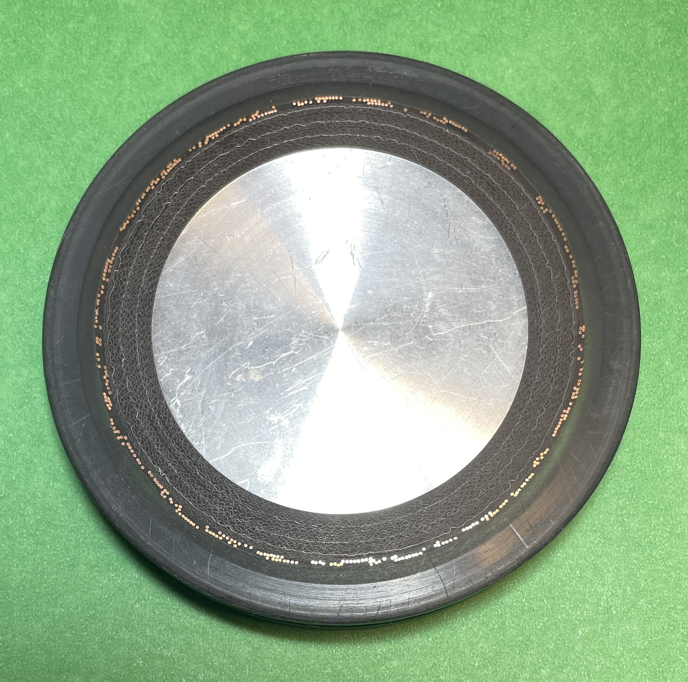
Bus Duct – Bus Pipe
May be employed for high current applications.
  A single set of bus pipes may replace many paralleled cables.
Allows for much tighter bend radius as compared to cable.
  May be useful in areas with significant arrangement challenges.
Large separation between conductors may result in unacceptable magnetic fields.
  Coaxial bus pipe currently under development.

Slide 9
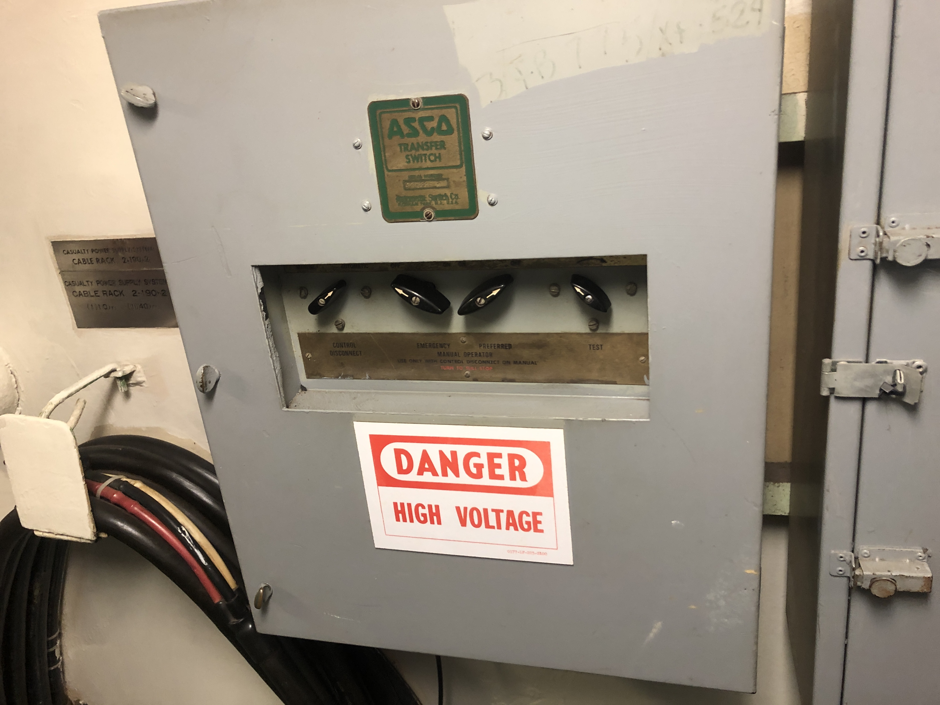
Bus Transfer Switches
Enable selecting between a normal and alternate source of power for a load (or set of loads).
  Usually provided for mission critical loads.
Manual Bus Transfer (MBT)
  A manual switch between two sources.
Automatic Bus Transfer (ABT)
  A switch that automatically switches to the alternate source upon loss of power to the normal source.
  May automatically switch back to the normal source when the normal source is restored.
  May delay switching such that phase is matched.
Controllable Bus Transfer (CBT)
  Similar to ABT, but also connected to machinery control system to enable remote monitoring and control.
Static Bus Transfer (SABT)
  Uses power electronics instead of mechanical switches.
  Can transfer power in less than 5 ms for a 60 Hz system.

Slide 10
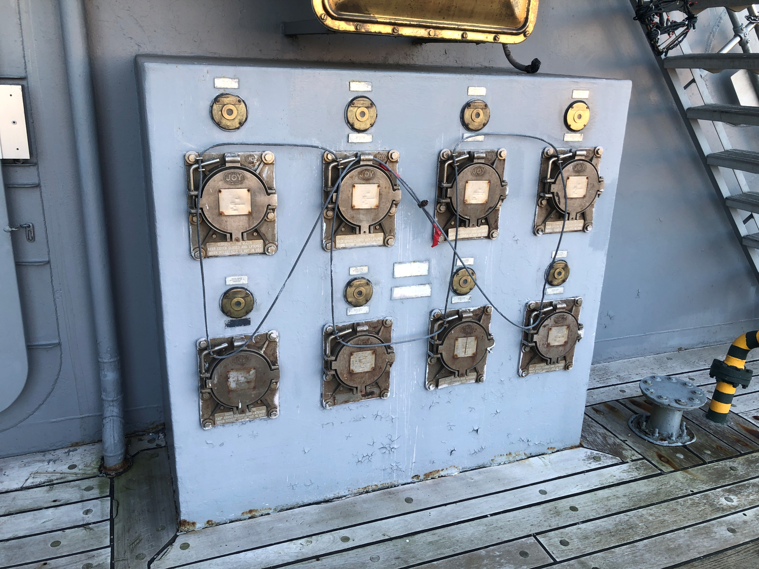
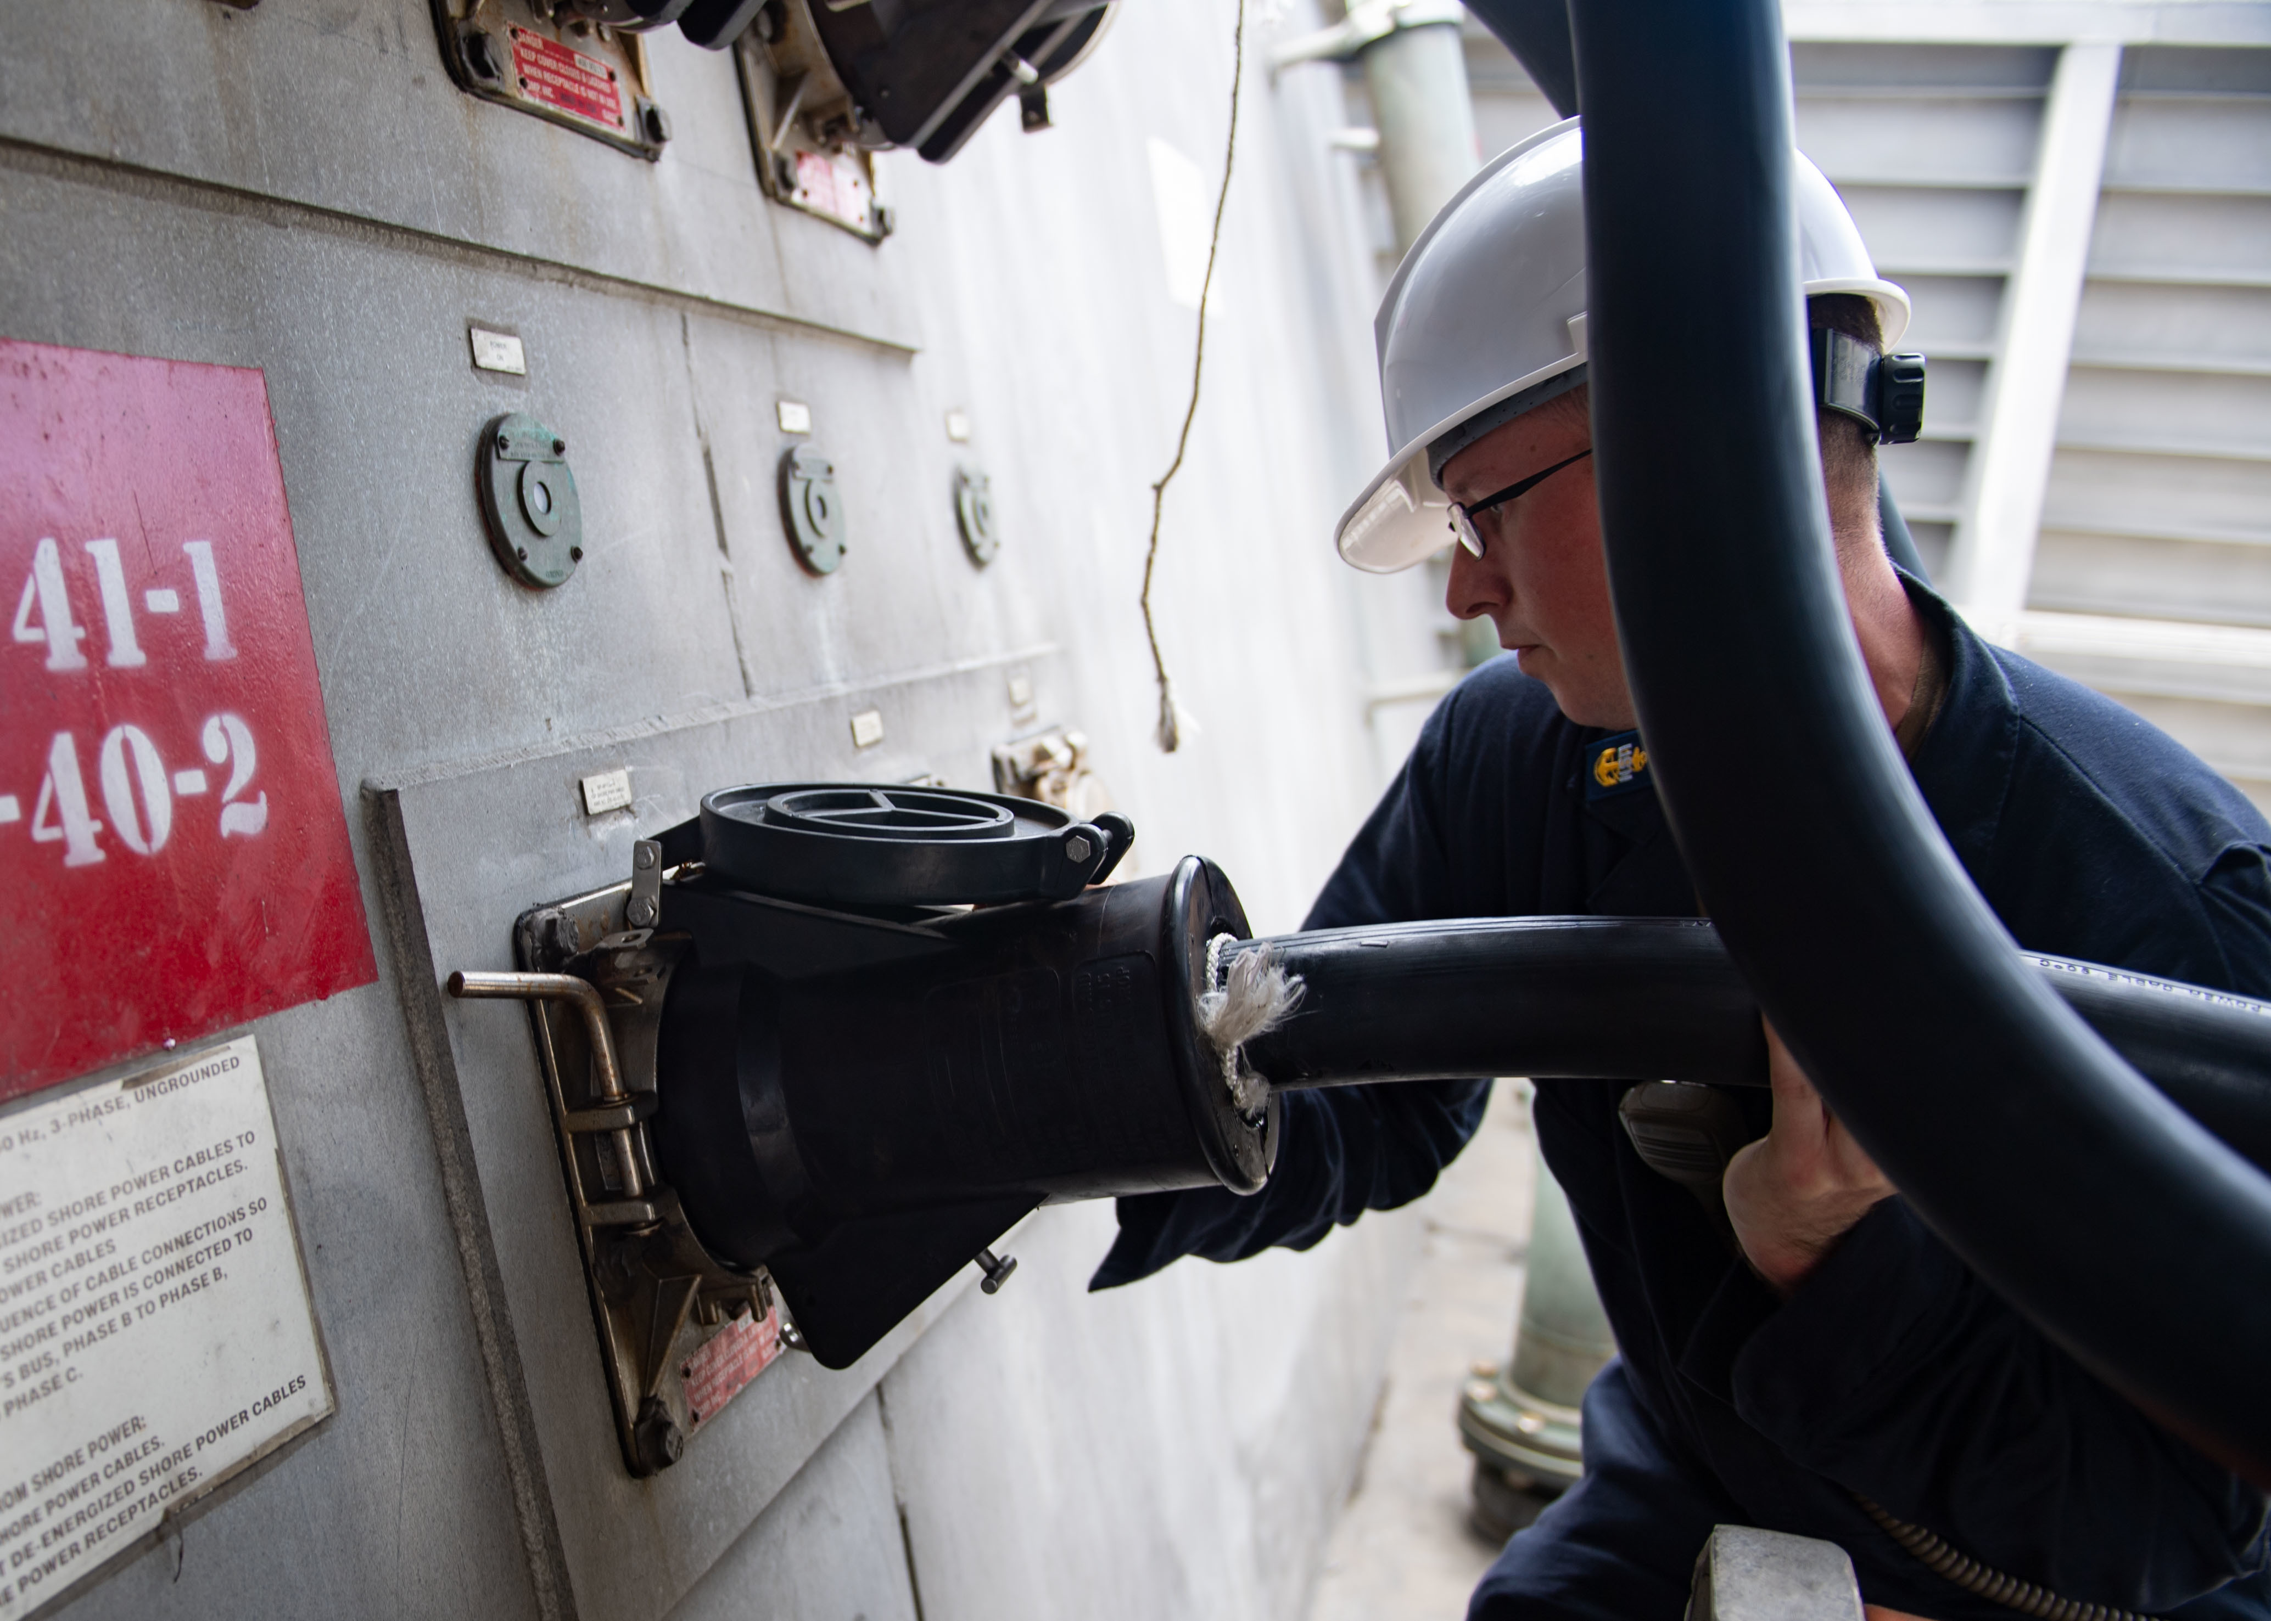
Shore Power Connections
Enable powering the ship from the terrestrial grid when in port.
Most naval ships use multiple 450 volt, 400 amp cables connected in parallel.
Some ships use medium voltage shore power connections.
  Large naval ships
  Cruise ships
  Other commercial ships

Slide 11
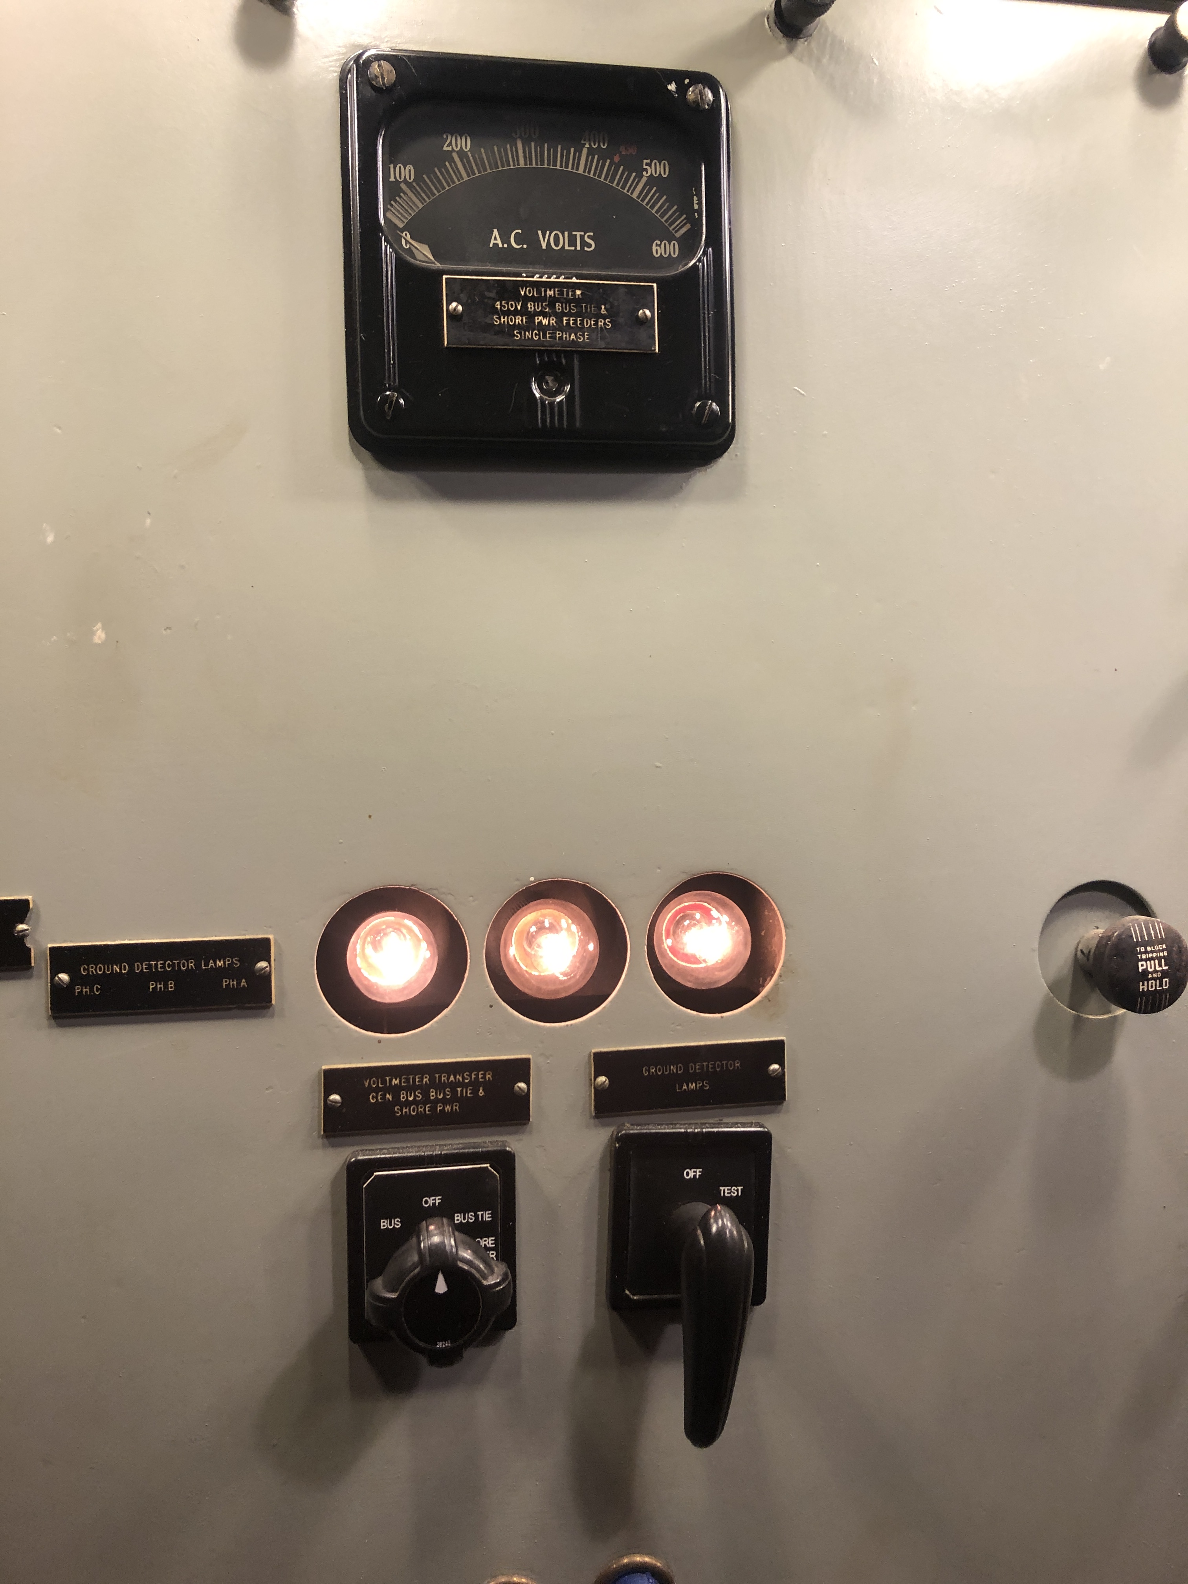
Grounding System
Distribution system may include equipment to implement a desired grounding scheme.
  Grounding transformers.
  Neutral grounding resistors.
Ungrounded and high resistance grounded systems incorporate equipment to detect ground faults.
  Ground detection lights.
  Ground detection sensors.
  Insulation monitoring systems.

Slide 12
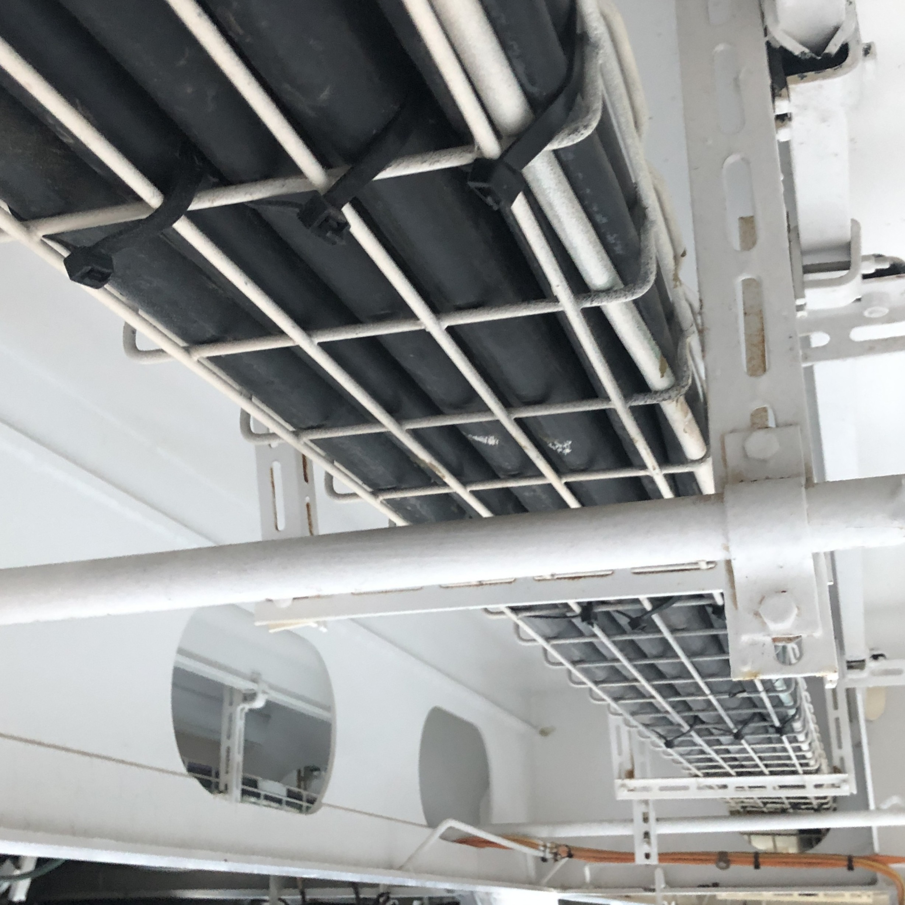
Cable Selection: Introduction
Power cables selected based on:
  Shipboard environment
  Ampacity
    Current rating
  Voltage drop
    Voltage stays within limits at the load
  Voltage rating
    Insulation does not fail

Slide 13
Cable Selection: Shipboard environment
Cables that penetrate watertight boundaries should themselves be watertight;
Cables should be light weight;
Cables should minimize the amount of smoke produced when subject to fire;
Cables should not out-gas toxic substances under normal conditions and when exposed to fire;
Cables should not degrade in a shipboard atmosphere including salt and petroleum products;
Cables should have a reasonable bend radius to facilitate installation onboard ship;
Cables should be undamaged during the installation process via cable pulling;
Cables should be designed to last the service life of the ship.

Slide 14
Cable Selection: Ampacity
Ampacity is the current carrying capacity of a cable’s conductors (or phase if multiple conductors assigned to same phase).
Depends on …
  Size of conductor
  Type and thickness of insulation
  Temperature of the ambient air
  How close the cable is mounted to other current carrying cables
Data sheets will list the ampacity for a specific ambient air temperature and specific cable mounting details.
  Should be adjusted (if necessary) to reflect actual conditions onboard ship
Load flow analysis provides estimates for the required ampacity.
Multiple cables may be connected in parallel if a single cable would be so large as to have an unacceptable bend radius.

Slide 15
Cable Selection: Voltage Drop
A cable with sufficient ampacity may have excessive voltage drop if too long.
Voltage drop calculations are performed to see if voltage drop is a potential issue.
Mitigations include …
  Increasing size of conductors within the cable.
  Power factor correction of loads.
  Solid-state transformers and regulated power converters.
  Adjustment of transformer secondary voltage.

Slide 16
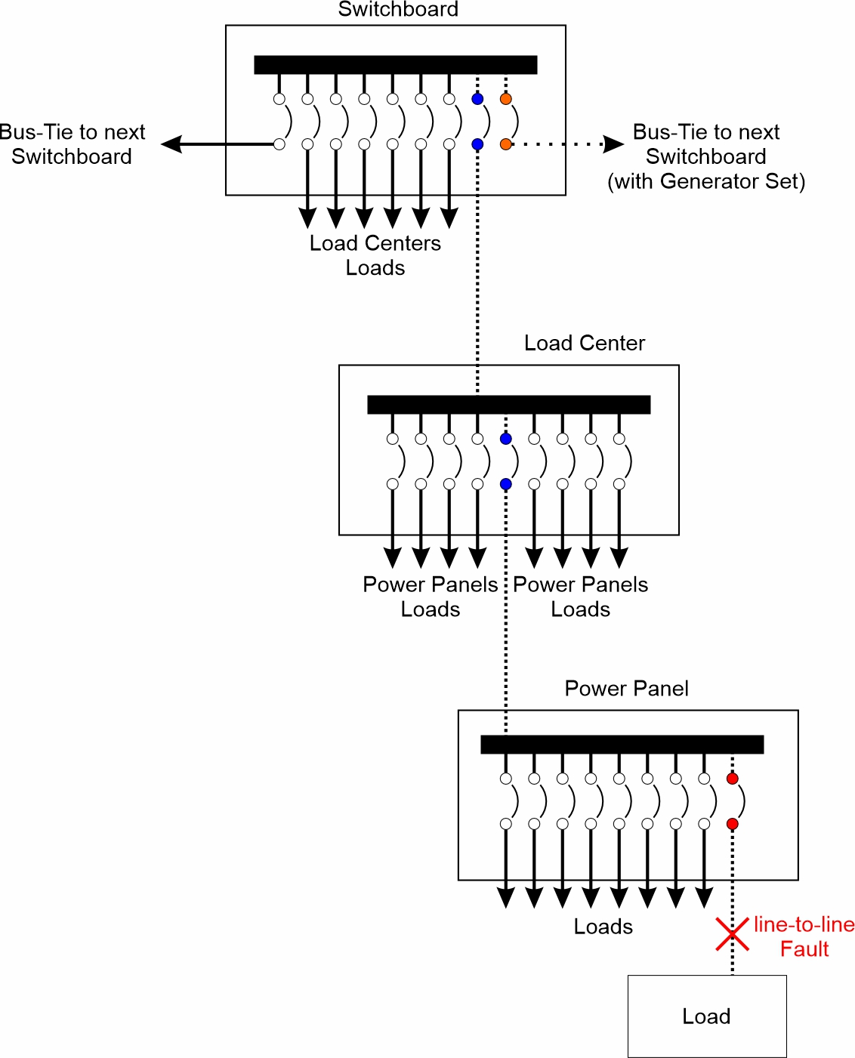
Circuit Breakers: Introduction
Fault protection
  Detect and isolate faults such that power is interrupted to the minimum number of loads.
Circuit breaker coordination
  In a radial system
    Sources of power are at one end
    Loads are at the other end
    Multiple circuit breakers between sources and a load
  During a fault
    All circuit breakers between sources and fault will experience fault current
    Desire is to only trip the circuit breaker immediately “upstream” from the fault.
  Circuit breaker coordination ensures the correct circuit breaker trips
    Accomplished by selecting / programming the desired current vs time curve for each circuit breaker.

Slide 17
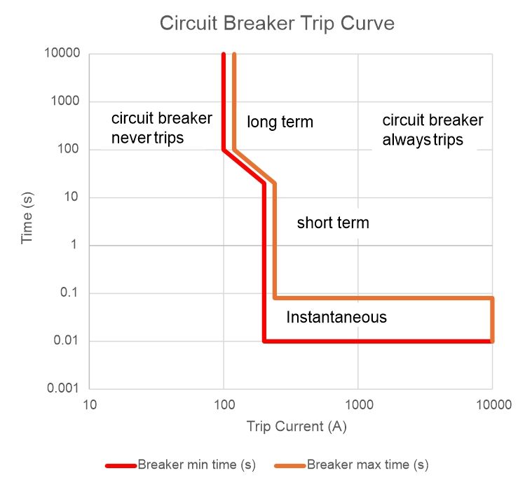
Circuit Breakers: Trip Curves
For each level of current, there is a minimum and maximum time for the circuit breaker to trip.
  Below the trip current continuous rating, the circuit breaker is designed to never trip.
  For long periods of time, the circuit breaker will trip with a small overload.
    Don’t want the cables downstream of the circuit breaker to overheat.
  For short periods of time, the overload must be greater than for long periods of time.
    Don’t want the circuit breaker to trip due to inrush current when loads turn on.
  If the current is really large, then have a fault and the circuit breaker trips quickly.
    Instantaneous trip setting.

Slide 18
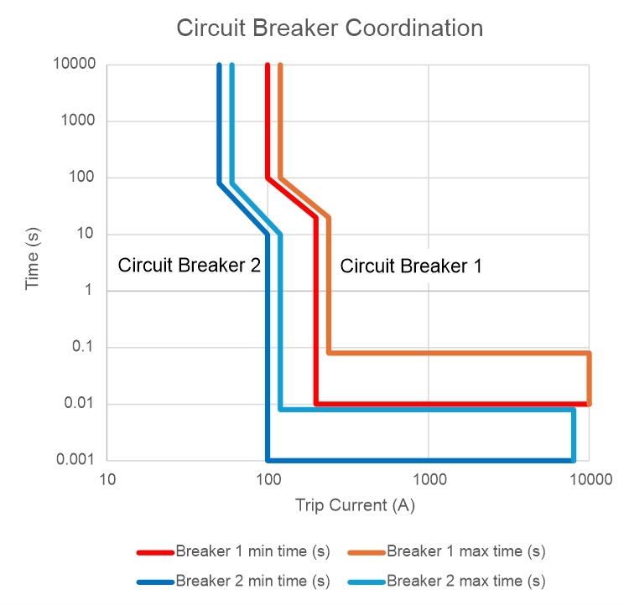
Circuit Breaker Coordination
Circuit breaker coordination.
  The “upstream” circuit breaker should always take longer to trip for a given current level than “downstream” circuit breakers.
If the fault is downstream of the downstream circuit breaker, the downstream circuit breaker will trip.
  The upstream circuit breaker will experience the fault current, but the downstream circuit breaker should trip first.
If the fault is between the two circuit breakers, the upstream circuit breaker will trip.
  The downstream circuit breaker will not experience the fault current.
Alternate methods required for bus-ties.
  No upstream or downstream – current may normally flow in either direction.

